Slide 1


Welcome to the Number Puzzle Game
Number Puzzle
Engage your mind with this fun number challenge!

Slide 2

Introduction: Saving Game Progress
File Save Mechanism
Data Persistence
The file save mechanism allows players to store their game progress, ensuring they can continue from where they left off, enhancing user experience and engagement significantly.
Data persistence enables the game to remember user stats and settings over sessions, saving essential information securely and allowing for a seamless gameplay experience whenever players return.

Slide 3


Game Mechanics
Understanding the core mechanics of the number puzzle game is essential for players to engage effectively and enhance their gameplay experience while strategizing for high scores.

Slide 4

Code Explanation:
rand() function is used to generate the puzzle number.
A loop allows multiple attempts.
The number of attempts is counted as the player’s score.
Fewer attempts = better score.
Key Concepts Used:
Loops (while)
Conditional statements (if-else)
Random number generation
  User input/output

Slide 5

Advantages:
Improves logical thinking
Enhances programming skills
Permanent score storage
Introduction to file handling
Increases user engagement
Simple and easy to implement
Real-world application relevance
Project expandability
Useful for lab exams and viva
Builds coding confidence

Slide 6

High Score Achievement Statistics
Tracking Player Success in the Game
85%
65%
Players Achieving High Scores
Average Score of Players
This percentage reflects top player performance.
Indicates the typical score achieved by players.

Slide 7

Displaying the Leaderboard
The leaderboard showcases players' achievements and rankings, providing motivation and fostering competition among users. It efficiently lists scores and players, enhancing the gaming experience.

Slide 8
Code Explanation: Input Validation
User Input Checks
Error Handling
Data Security
Input validation ensures the user enters valid data, preventing errors and maintaining game stability by checking for acceptable formats and value ranges before proceeding.
Implementing robust error handling alerts users to invalid entries with clear messages, guiding them to correct mistakes and enhancing overall user experience and engagement in the game.
Validating input also protects the game from malicious inputs, ensuring data integrity and security by rejecting harmful data that could disrupt normal operations or exploit vulnerabilities.

Slide 9

Saving High Scores in the Game
File Structure
Data Serialization
Error Handling
The game saves high scores using a structured file format, ensuring data integrity and easy access. A consistent naming convention facilitates organized retrieval of player information.
Robust error handling is implemented during the file save process, ensuring that any issues are logged and communicated to the user. This maintains a smooth gaming experience and user trust.
High scores are serialized into a format that can be easily written to files, typically using JSON or CSV. This process allows for efficient storage and retrieval of player statistics.

Slide 10

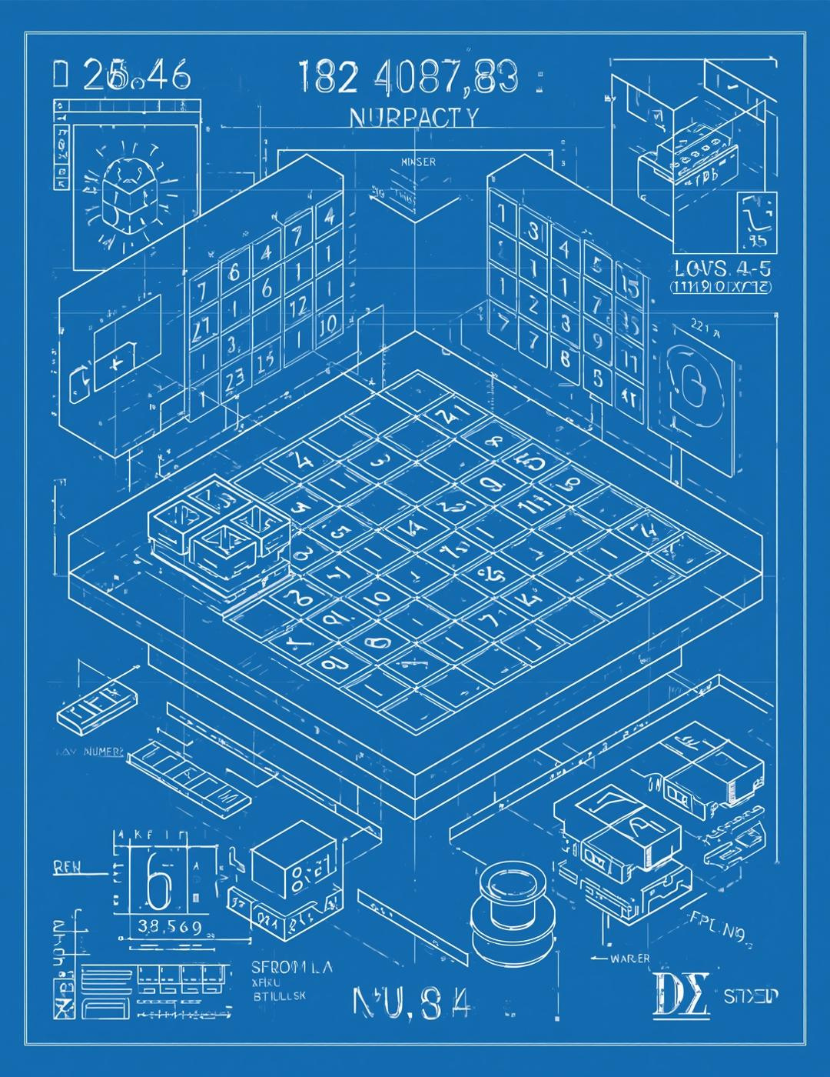
Thank you!
V.Girija madhuri-25A31A04F7
Y.Abhila priya-25A31A04F8
R.Janaki mani charan-25A31A04I8
S.Siva sai sriram-25A31A04I9

